Slide 1
Basic human aspirations
Aspiration:
can be stated as strong desire to achieve something for e.g. Success, aspiration means desire goal and objective of life.

Slide 2
Long lasting happiness, becoming joyous, loving person, attaining peace of mind- these all exist and present in universe but reactivity is absent.

Slide 3
We desire many thing like materialistic need respect ,recognition, love trust etc. but in the form of all these desire we are actually looking for continuous happiness and prosperity .
Basic human aspiration is continuous happiness and prosperity.

Slide 4
Happiness
“To be in a state of liking, to be in a state of harmony is happiness.”
There are certain situations when we feel happy situations which we are able to accept effortlessly and naturally.
There are situations that we accept naturally like being successful, being comfortable with others, feeling respect and confidence etc.

Slide 5
On the other hand there are certain states of being that we do not accept naturally like being cheated, being deprived of material comforts, being in conflict with friends etc. this is states of unhappiness.

Slide 6
Happiness is a mental state of well being characterized by positive emotion of intense of joy, contentment and good life.

Slide 7
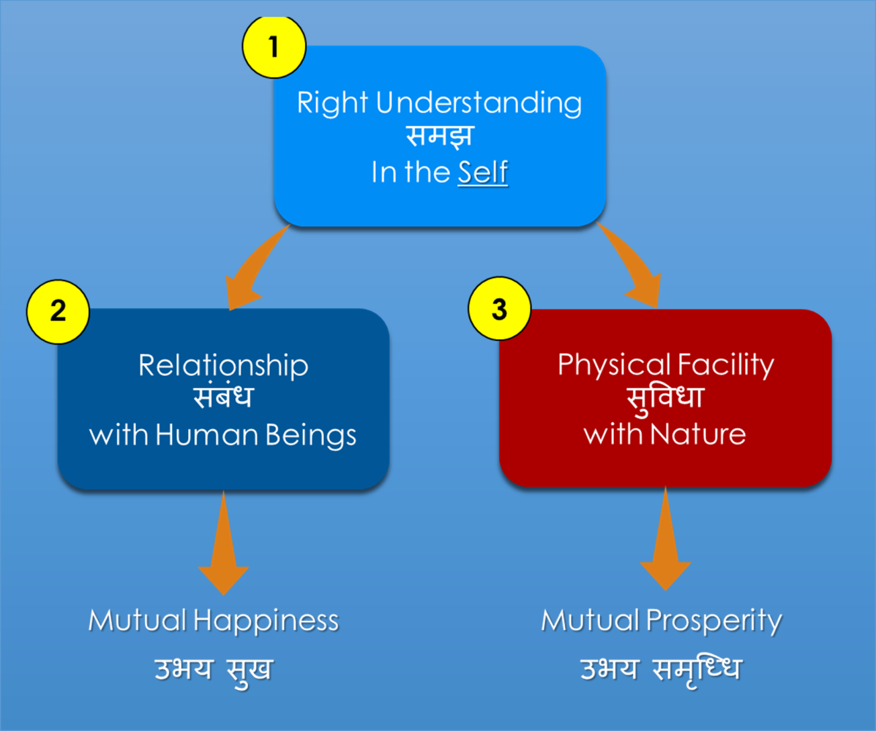

Slide 8
Right understanding : this refers to higher order human skill- need to learn and utilise our intelligence most effectively.
Good relationship: this refers to interpersonal relationship that person builds in his life- at home ,at work place, and society.
Physical facilities: this includes the physiological needs ands of individuals and indicates the necessities as well as comforts of life.

Slide 9
Importance of happiness
As we become happier-
We become better people.
We become more compassionate.
Able to enhance our creativity.
More energetic , perform task efficiently.
Develop healthy mind and right understanding.
Work towards creating better world.

Slide 10
Notions of Happiness and Prosperity in the society are:
In the current scenario, we are generally trying to achieve happiness and prosperity by maximizing accumulation and consumption of physical facilities. This is an attempt to achieve happiness through pleasant sensory interactions. The physical facilities are not seen in terms of fulfilling bodily needs but as a means of maximizing happiness.

Slide 11
This has resulted in wrong assessment of wants for physical facilities as being unlimited.
Some of the consequences of such a trend are summarized below:
At the level of Individual: Problems of depression,
psychological disorders, suicides, stress, insecurity, psycho-somatic diseases, loneliness etc.

Slide 12
At the level of family: Breaking of Joint families, mistrust, conflict between older and younger generations, insecurity in relationships, divorce, dowry tortures, family feuds, wasteful expenditures in family functions etc.
At the level of Society: Terrorism, naxalism, communism,casteism, racial, ethnic struggles, wars between nations, genocide, nuclear genetic warfare.

Slide 13
At the level of Nature: Global Warming, pollution, depletion of mineral resources, deforestation, loss of soil fertility.

Slide 14
Right Understanding: Right Understanding helps us to maintain proper relationships with other human beings and also helps us to make a proper choice of physical facilities. Hence the needs of all human beings consist of the need for – Right Understanding, Relationships and Physical Facilities in the right order.

Slide 15
Prosperity:-
The material things or what we say physical facilities is related to prosperity.
It is conception that to acquire more physical facilities are prosperity. To know what prosperity is two things are essential.

Slide 16
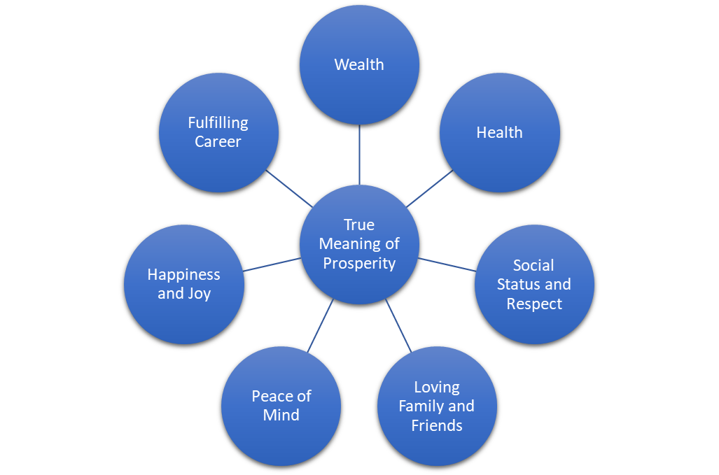

Slide 17
a) Correct assessment of need for physical facilities.
b) The competence of making available more than required physical facilities.
One thing can be clearly stated that we can prosperous only if there is a limit to the physical facilities. If there is no limit The feeling of prosperity can’t be assured.

Slide 18
Secondly just assessing the need is not enough. We need to be able to produce or make available more than the need.
Suppose, a person has a lot of money, but does not want to share even a bit of it.

Slide 19
So, Wealth is a physical thing. It means having money or having a lot of physical facilities or both.
Prosperity is a feeling of having more than required physical facilities. It is not just physical facilities.

Slide 20
It is the misconception in the society that only accumulate physical facilities are prosperity. But we need to understand it clearly.
The basic requirements for fulfilling the aspirations are:-

Slide 21
Right Understanding:-This refers to our skills – the need to learn and utilize our intelligence effectively.
Good Relationships:-This refers to the interpersonal relationships that a person builds at home, at the workplace and in society.

Slide 22
Physical Facilities:-This includes the physical needs of individuals and indicates the necessities as well as the comforts of life.

